Slide 1
Chapter 7 Control Statements Continued
Fundamentals of Java: AP Computer Science Essentials, 4th Edition
Lambert / Osborne

Slide 2
Objectives
Construct complex Boolean expressions using the logical operators && (AND), || (OR), and ! (NOT).
Construct truth tables for Boolean expressions.
Understand the logic of nested if statements and extended if statements.
Test if statements in a comprehensive manner.
‹#›
‹#›

Slide 3
Objectives (continued)
Construct nested loops.
Create appropriate test cases for if statements and loops.
Understand the purpose of assertions, invariants, and loop verification.
‹#›
‹#›

Slide 4
Vocabulary
arithmetic overflow
boundary condition
combinatorial explosion
complete code coverage
equivalence class
extended if statement
extreme condition
input assertion
logical operator
loop invariant
loop variant
‹#›
‹#›

Slide 5
Vocabulary (continued)
nested if statement
nested loop
output assertion
quality assurance
robust
truth table
‹#›
‹#›

Slide 6
Logical Operators
Java includes three logical operators:
Equivalent to their meaning in English.
Used in Boolean expressions that control the behavior of if, while, and for statements.
AND: if both operands are true, the condition is true. If either or both are false, the condition is false.
OR: The condition is false only if both operands are false.
NOT: If the operand is true, the condition is false.
‹#›
‹#›

Slide 7
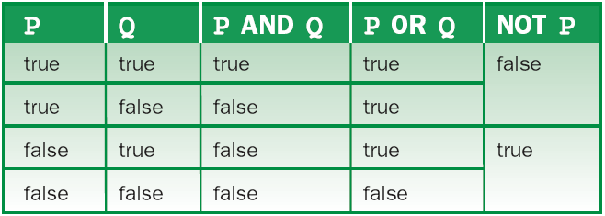
Logical Operators (continued)
General rules for AND, OR, and NOT
‹#›
‹#›

Slide 8
Logical Operators (continued)
Three Operators at Once:
Combine operators to create complex conditions.
Add parentheses to remove ambiguity.
Example: If (the sun is shining AND it is 8 a.m.) OR (NOT your brother is visiting) then let’s go for a walk; else, let’s stay at home.
When do we walk? At 8 a.m. on sunny days or when your brother does not visit.
‹#›

Slide 9
Logical Operators (continued)
Java’s Logical Operators and Their Precedence:
AND is represented by &&
Comes after relational operators
OR is represented by ||
Comes after AND, and before assignment operators
NOT is represented by !
Same precedence as +, -
‹#›
‹#›

Slide 10
Logical Operators (continued)
Examples Using Logical Operators:
A Boolean variable can be true or false, and used to simplify a Boolean expression.
bothHigh, atleastOneHigh, etc.
Rewrite a complex if statement as a series of simpler statements.
Javish: combination of English and Java.
Create a truth table before rewriting.
‹#›
‹#›

Slide 11
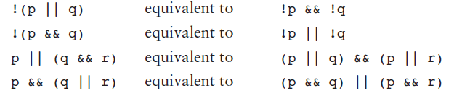
Logical Operators (continued)
Some Useful Boolean Equivalences:
The following pairs of expressions are equal:
Use equivalences to rewrite a condition in a more easily understandable form.
‹#›
‹#›

Slide 12
Logical Operators (continued)
Short-Circuit Evaluation:
When the JVM knows the value of a Boolean expression before evaluating its parts, it does not evaluate the parts.
In complete evaluation, all parts are evaluated.
‹#›
‹#›

Slide 13
Testing if Statements
Quality assurance is the process of making sure software is developed to the highest standards given constraints of time and money.
At minimum, test data should try to achieve complete code coverage.
When all lines of code are tested at least once.
Not the same as testing all logical paths.
‹#›
‹#›

Slide 14
Testing if Statements (continued)
Equivalence class: all the sets of test data that exercise a program in the same manner.
Boundary conditions: test data that assesses a program’s behavior on or near the boundaries between equivalence classes.
Extreme conditions: data at the limits of validity.
Must also test data validation rules.
Enter values that are valid and invalid, and test the boundary values between the two.
‹#›
‹#›

Slide 15
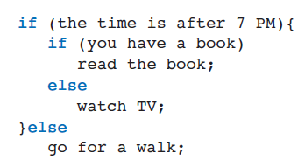
Nested if Statements
Nested if statements are an alternative to using logical operators in a complex program.
An everyday example of nested ifs written in Javish
‹#›
‹#›

Slide 16
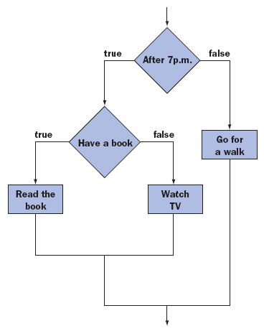
Nested if Statements (continued)
Flowchart for reading a book, watching TV, or going for a walk
‹#›
‹#›

Slide 17
Logical Errors in Nested if Statements
Removing the Braces:
Better to overuse braces than underuse.
Braces and indentation can also help readability.
Avoiding Nested if statements:
Sometimes helps to avoid logical errors.
Rewrite as a series of independent if statements.
‹#›
‹#›

Slide 18
Nested Loops
A nested loop is a loop inside another loop.
Example: determining if a number is prime.
Nesting a for loop inside another for loop.
Compute all the primes between two limits.
To enter another pair of limits, enclose the code in yet another loop.
‹#›
‹#›

Slide 19
Testing Loops
Looping statements make it challenging to design good test data.
Frequently, loops iterate zero, one, or more than one time depending on a program’s inputs.
Combinatorial Explosion:
When the behavior of different program parts affects other parts, include all options in testing.
Multiplicative growth: number of parts * number of test data sets.
‹#›
‹#›

Slide 20
Testing Loops (continued)
Robust Programs:
A program that produces correct results when it has valid inputs is not good enough.
Must test using invalid data.
A program that tolerates and recovers from errors in input is robust.
‹#›
‹#›

Slide 21
Loop Verification
The process of guaranteeing that a loop performs its intended task, independent of testing.
The assert Statement:
Allows the programmer to evaluate a Boolean expression and halt the program with an error message if the expression’s value is false.
If true, the program continues.
‹#›
‹#›

Slide 22
Loop Verification (continued)
Assertions with Loops:
Input assertions: state what should be true before a loop is entered.
Output assertions: state what should be true when the loop is exited.
‹#›
‹#›

Slide 23
Loop Verification (continued)
Invariant and Variant Assertions:
Loop invariant: an assertion that exposes a relationship between variables that remains constant throughout all loop iterations.
True before the loop is entered, and after each pass.
Loop variant: an assertion whose truth changes between the first and final execution of the loop.
Guarantees the loop is exited.
‹#›
‹#›

Slide 24
Advanced Operations on Strings
Most text-processing applications examine the characters in strings, take them apart, and build new ones.
Example: extracting words from a string representing a line of text.
To obtain the first work, copy the string’s characters until you reach the first space or the length of the string.
‹#›
‹#›

Slide 25
Advanced Operations on Strings (continued)
Substring: part of an original string.
Other commonly used string methods:
charAt (anIndex): returns the character (char) at the position anIndex.
compareTo (aString): Compares two strings alphabetically and returns an int.
equals (aString): Returns Boolean (true if the strings are equal).
‹#›
‹#›

Slide 26
Advanced Operations on Strings (continued)
Counting the Words in a Sentence:
Example uses length, indexOf, and substring.
Accepts sentences as inputs from the keyboard.
Displays the number of words in each sentence and the average length of a word.
Assumes words are separated by at least one blank, and that punctuation is a part of a word.
Halts when user presses the Enter key.
‹#›
‹#›

Slide 27
Advanced Operations on Strings (continued)
Using a Scanner with a String:
A scanner can also be used to read words from a string.
The scanner automatically handles details such as skipping multiple spaces between words.
‹#›
‹#›

Slide 28
Graphics and GUIs: Timers and Animations
The Basic Principles of Animation:
Our perception of movement is based on rapid display of successive frames.
The basic tools for displaying the same object in multiple frames: changing the position of a graphical object, and repainting a panel.
Realistic depiction of motion depends on: speed, acceleration, friction, and object qualities such as bounciness for a ball.
‹#›
‹#›

Slide 29
Graphics and GUIs: Timers and Animations (continued)
Direction and Speed of Moving Objects:
Speed of a moving object: the distance (in pixels) traveled in a given unit of time, and a direction.
Using object-oriented style, the object tracks its own speed and direction.
The move ( ) method moves an object a given distance in a given direction.
‹#›
‹#›

Slide 30
Graphics and GUIs: Timers and Animations (continued)
Moving a Circle with the Mouse:
Example: program displays a filled circle at the center of the panel.
When the user presses the mouse, the circle moves 50 pixels in its current direction and turns 45°.
‹#›
‹#›

Slide 31
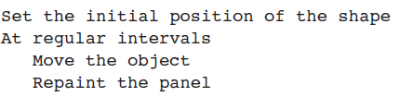
Graphics and GUIs: Timers and Animations (continued)
Timers:
The basic algorithm for animating a graphical object:
First step occurs when the panel is instantiated.
Last two are accomplished by sending messages to move the object and repaint the panel.
‹#›
‹#›

Slide 32
Graphics and GUIs: Timers and Animations (continued)
Timers:
A timer is an object to schedule events at regular intervals.
When instantiated, given an interval in milliseconds and a listener object.
When sent the start message, the clock starts, and with each interval, the listener’s actionPerformed method is triggered.
Once started, a timer fires events until it is stopped or the program quits.
The Timer class includes methods for stopping a timer, restarting, changing interval, etc.
‹#›
‹#›

Slide 33
Graphics and GUIs: Timers and Animations (continued)
A Final Example: A Bouncing Circle:
Example: program bounces a circle back and forth horizontally in its panel.
At startup, circle’s left side is flush with left panel border.
Moves continuously to the right until right side is flush with right panel border.
Reverses direction until left side is flush with left panel border, and repeats.
‹#›
‹#›

Slide 34
Design, Testing, and Debugging Hints
Most errors involving selection statements and loops are not syntax errors, and will only be detected after running the program or with extensive testing.
Braces can affect the logic of a selection statement or loop.
When testing if or if-else statements, use test data that exercises the logical branches.
‹#›
‹#›

Slide 35
Design, Testing, and Debugging Hints (continued)
When testing if statements, formulate equivalence classes, boundary conditions, and extreme conditions.
Use an if-else statement when alternate courses of action are mutually exclusive.
Use limit and typical values when testing a loop.
Check entry and exit conditions for loops.
Use debugging output statements to verify values of the control variable on each pass.
‹#›
‹#›

Slide 36
Summary
In this chapter, you learned:
A complex Boolean expression contains one or more Boolean expressions and the logical operators && (AND), || (OR), and ! (NOT).
A truth table can determine the value of any complex Boolean expression.
Java uses short-circuit evaluation of complex Boolean expressions. The evaluation of the operands of || stops at the first true value, whereas the evaluation of the operands of && stops at the first false value.
‹#›
‹#›

Slide 37
Summary (continued)
Nested if statements are another way of expressing complex conditions. A nested if statement can be translated to an equivalent if statement that uses logical operators.
An extended or multiway if statement expresses a choice among several mutually exclusive alternatives.
‹#›
‹#›

Slide 38
Summary (continued)
Loops can be nested in other loops.
Equivalence classes, boundary conditions, and extreme conditions are important features used in tests of control structures involving complex conditions.
You can verify the correctness of a loop by using assertions, loop variants, and loop invariants.
‹#›
‹#›

